Slide 1
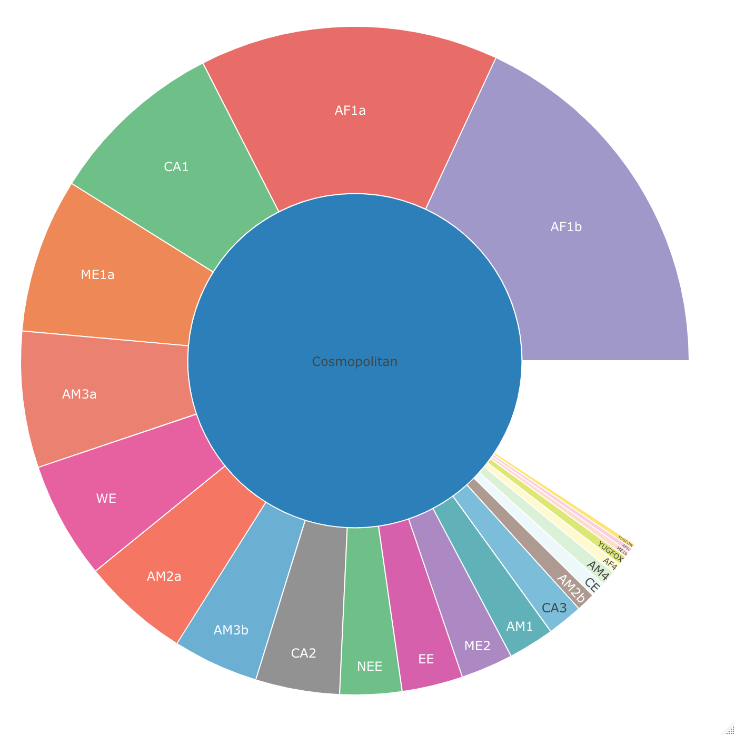
Cosmopolitan
Fig1: Hierarchal relationship of the 23 existing subclades of the cosmopolitan clade

Slide 2
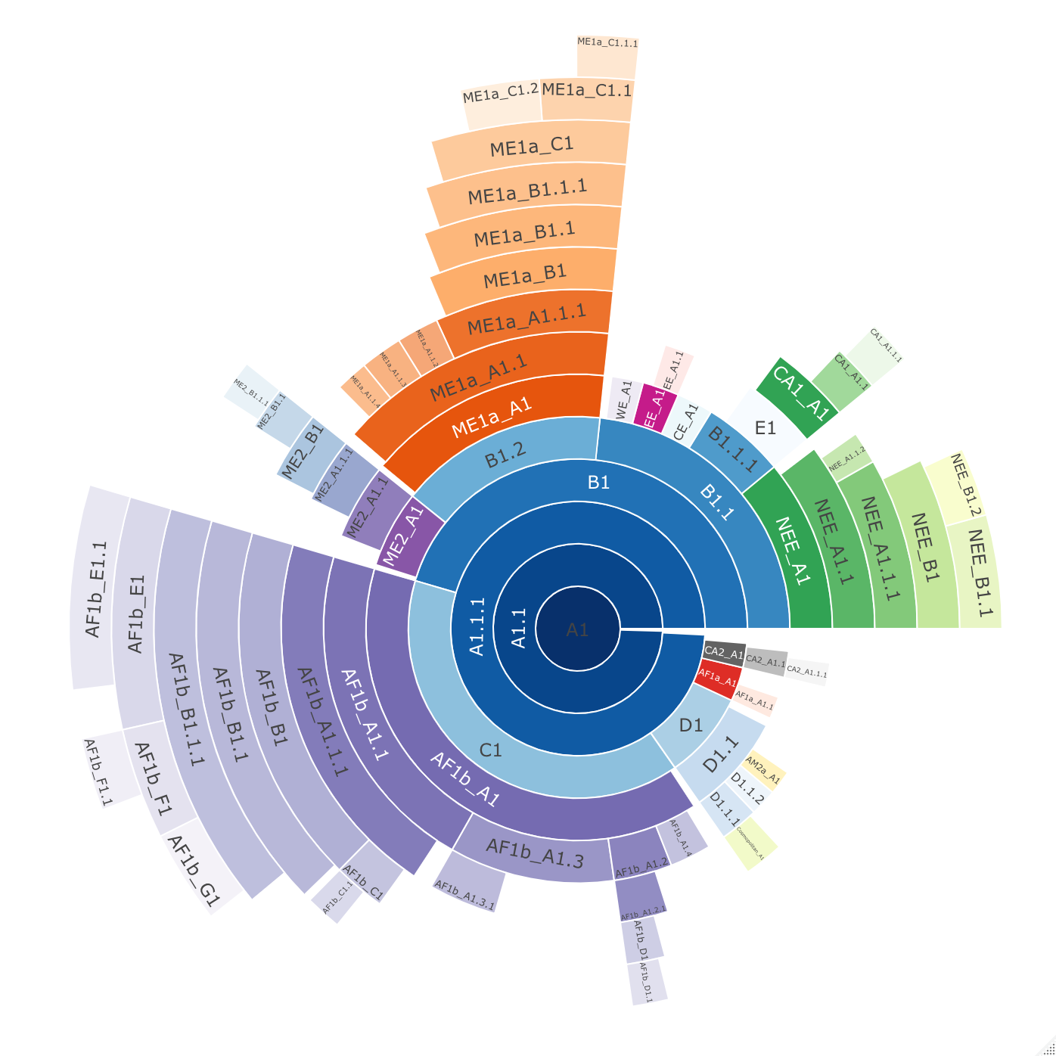
b)
a)
Fig2: Lineage designation of 650 whole genome (10,000nt) rabies virus sequences from the Cosmopolitan clade, obtained from RABV-GLUE. A) Maximum likelihood tree showing the lineage positions with terminal lineages collapsed. B) Hierarchal relationships of the lineages.

Slide 3
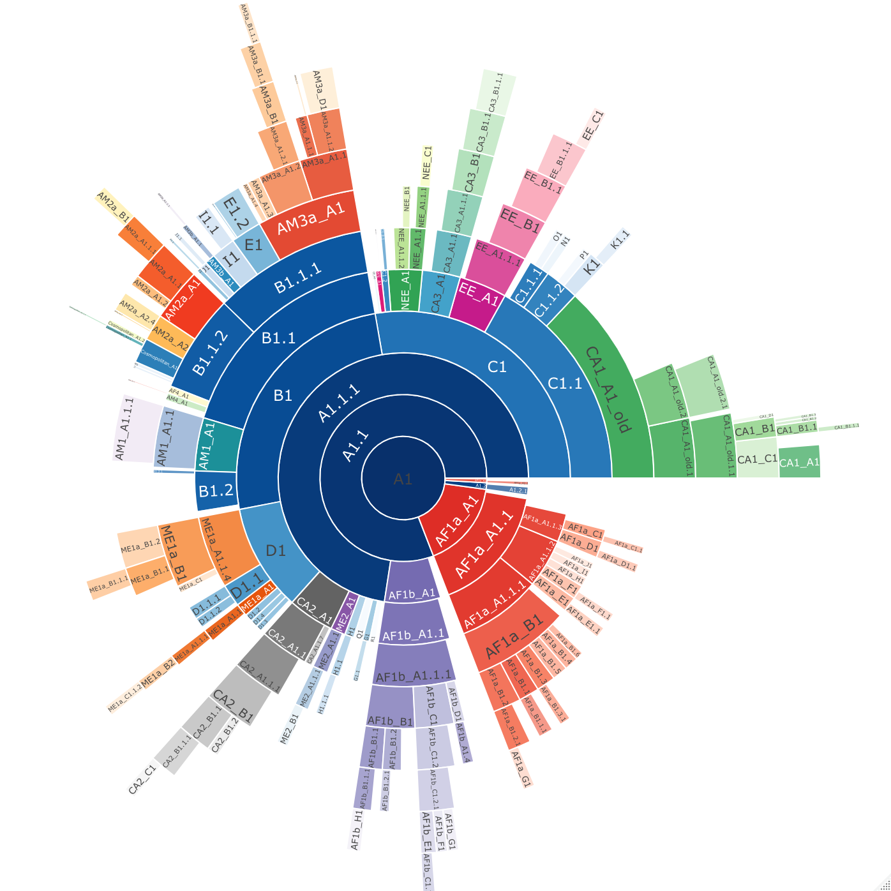
b)
a)
Fig3: Lineage designation of 2126 N gene length (1300nt) rabies virus sequences from the Cosmopolitan clade, obtained from RABV-GLUE. A) Maximum likelihood tree showing the lineage positions with terminal lineages collapsed. B) Hierarchal relationships of the lineages.

Slide 4
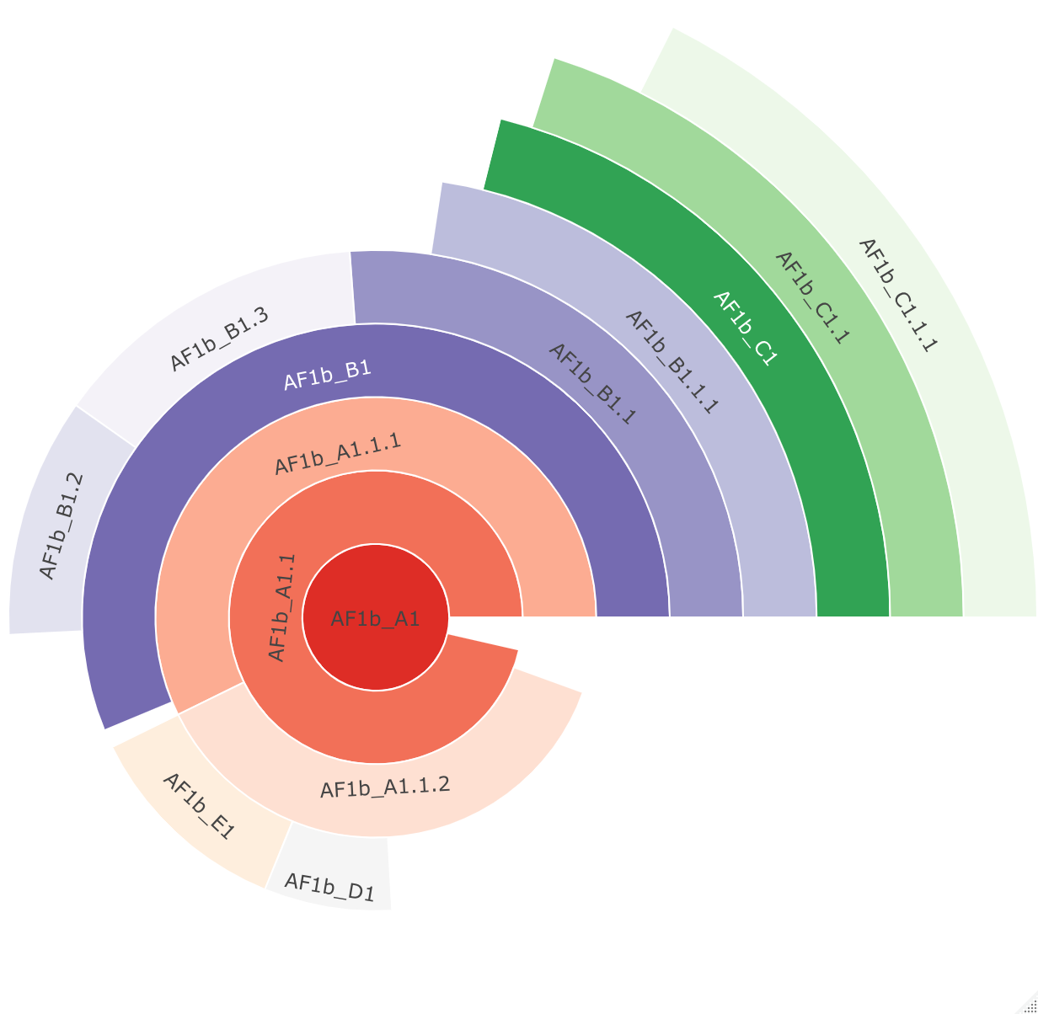
a)
b)
Fig4: Lineage designation of 205 whole genome (10,000nt) rabies virus sequences from the Tanzania, obtained from RABV-GLUE. A) Maximum likelihood tree showing the lineage positions with terminal lineages collapsed. B) Hierarchal relationships of the lineages.

Slide 5
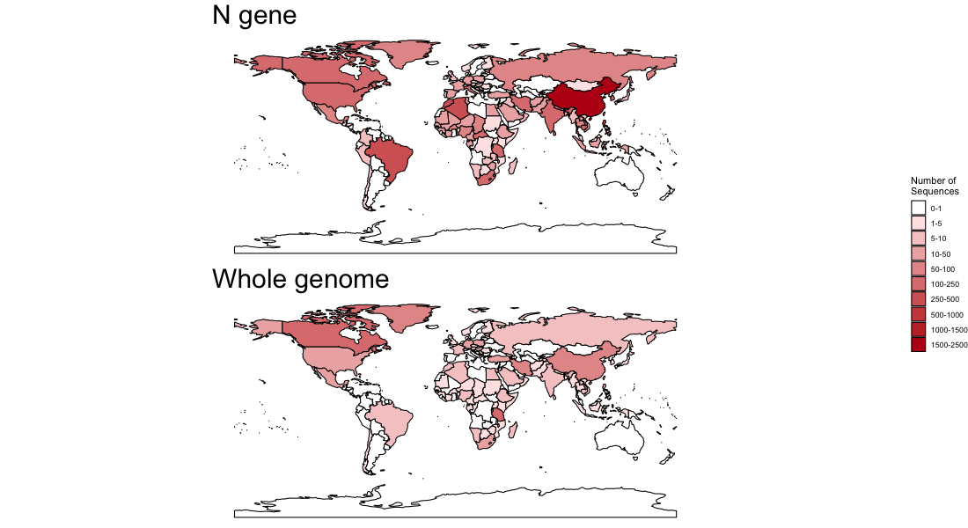
Fig5: Number of publicly available rabies virus sequences available per country of at least N gene length - 1300nt (n = 2126), and whole genome sequences - >10,000nt (n = 650).

Slide 6
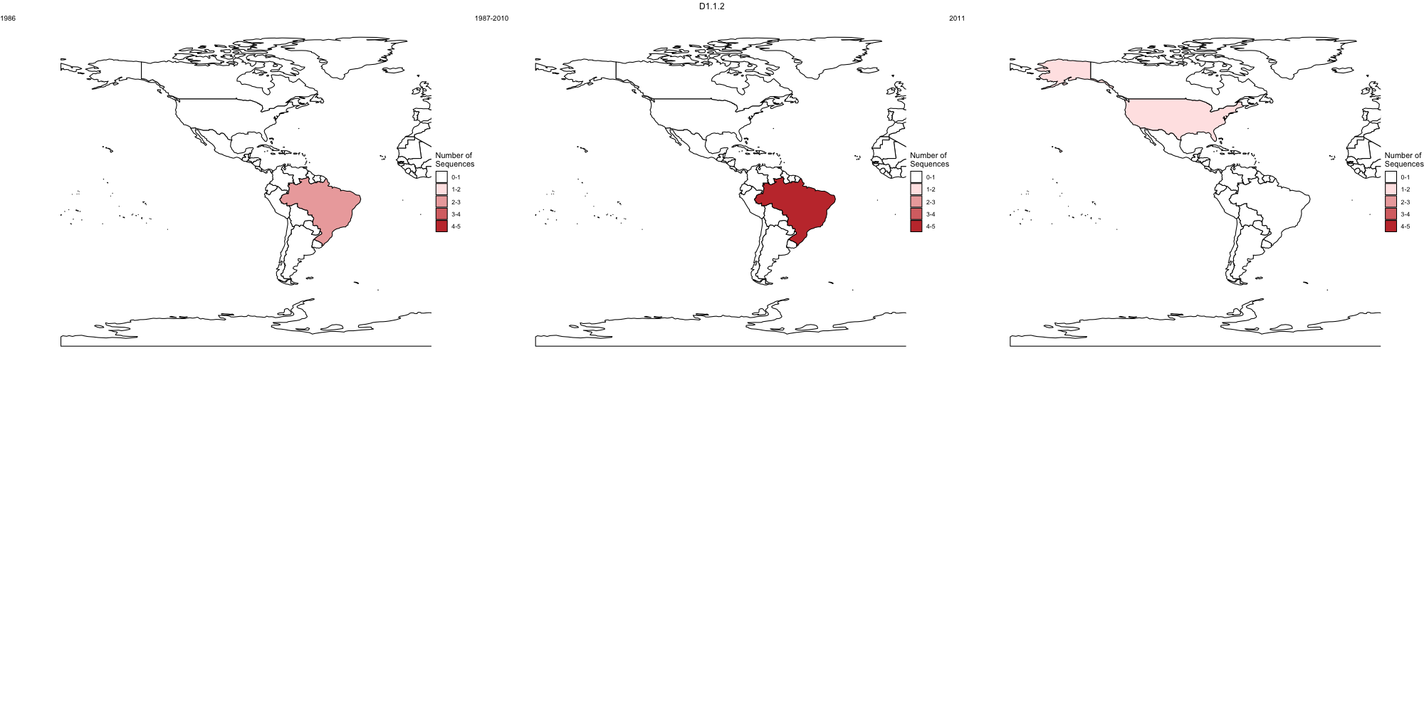
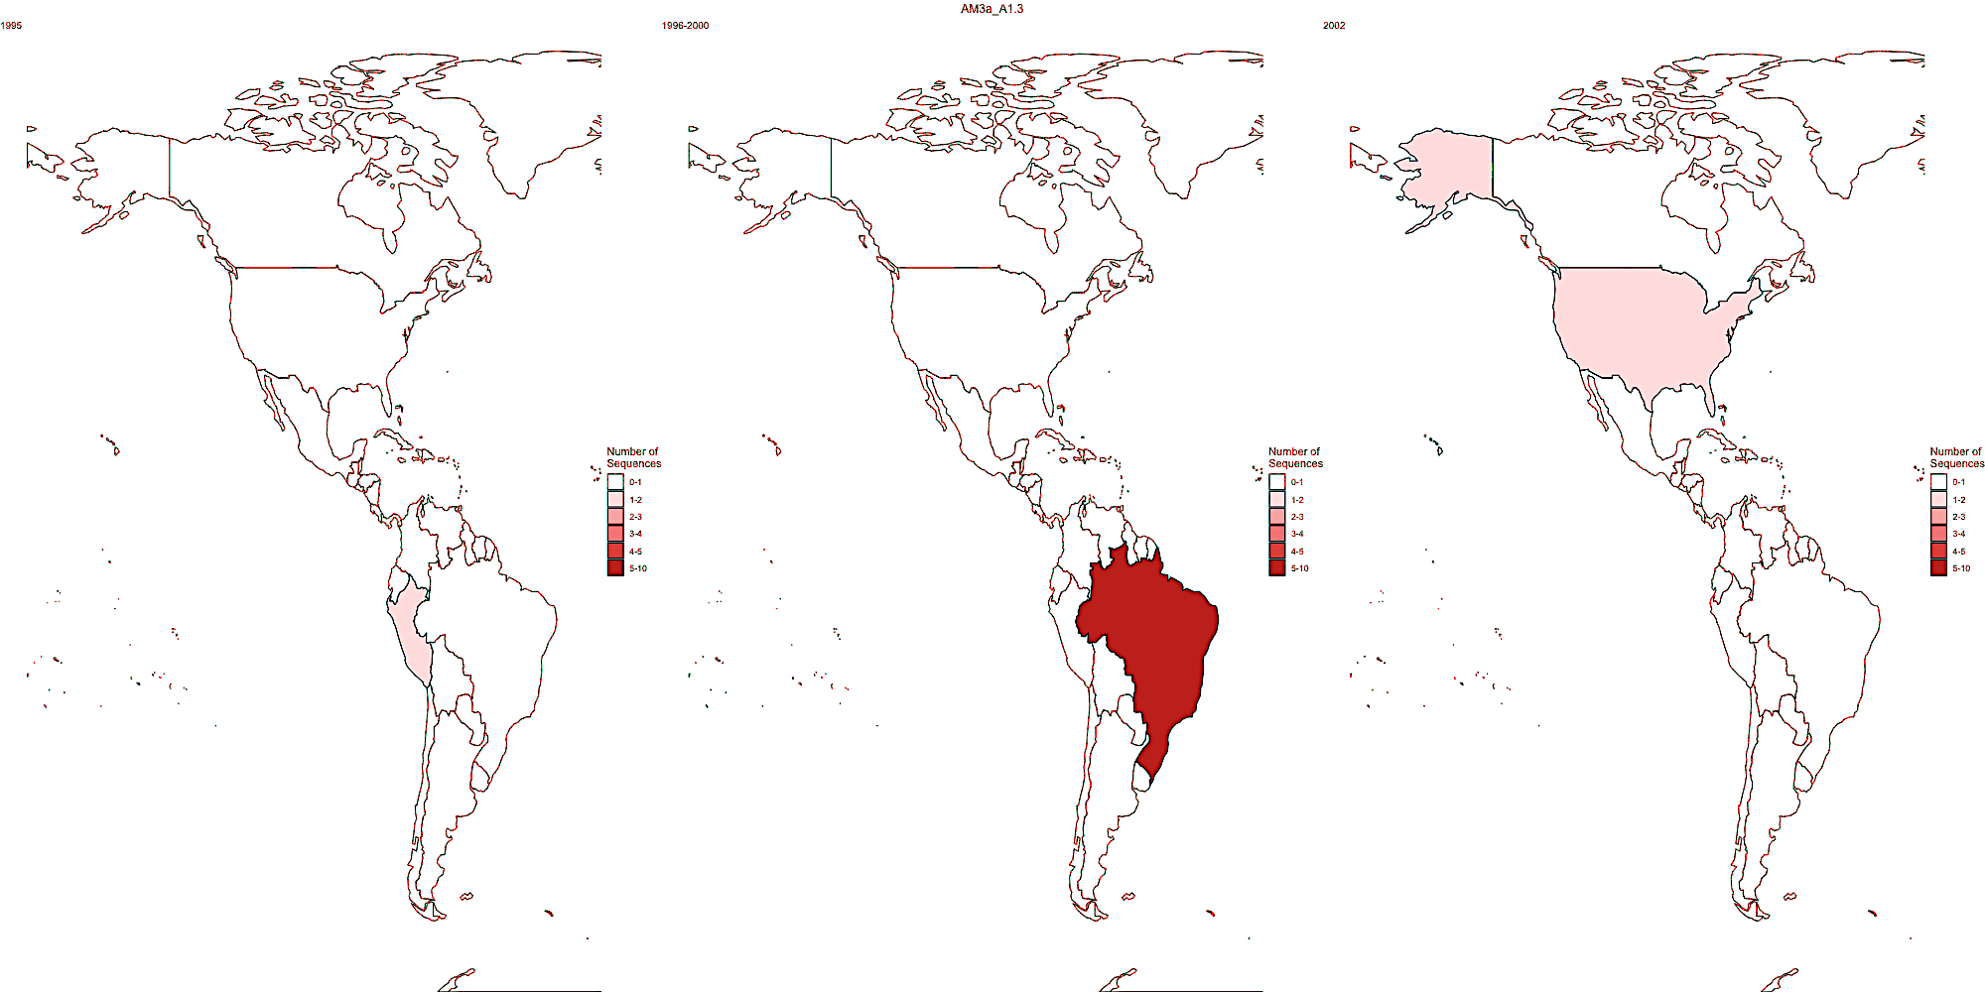
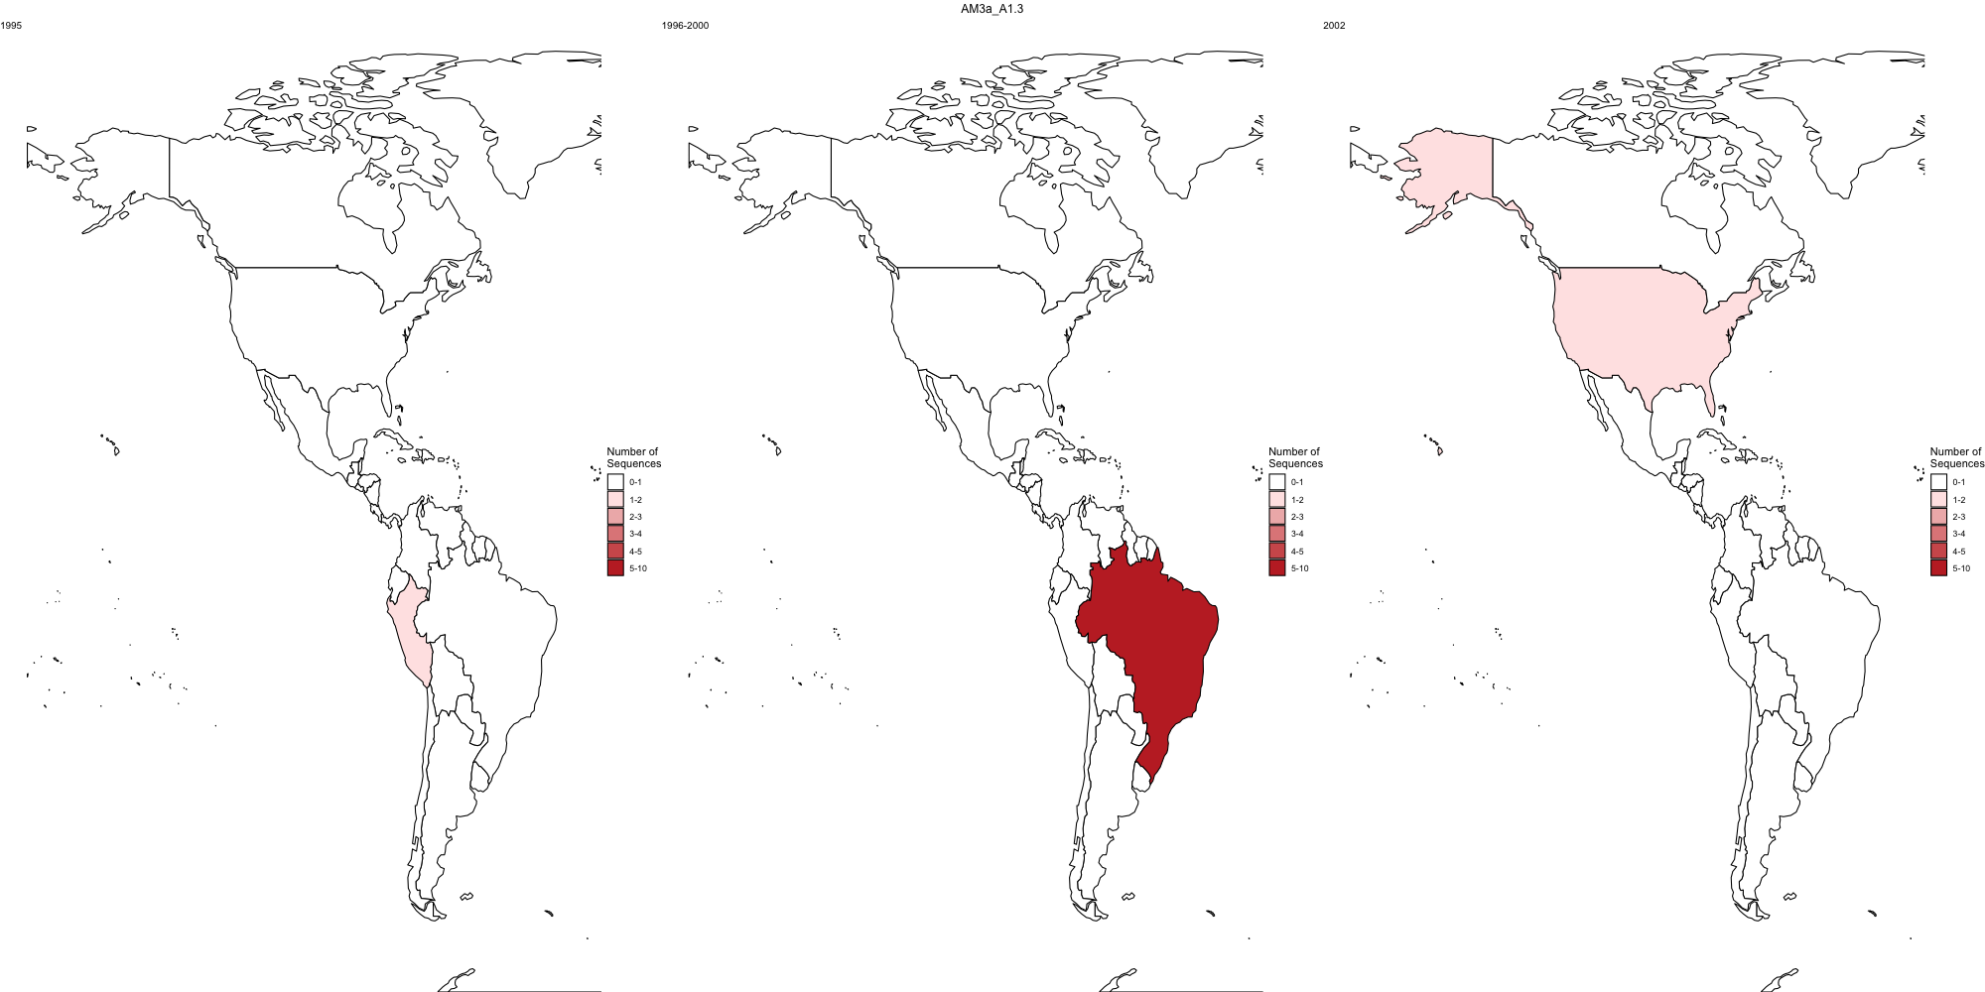
Whole genome lineage D1.1.2
1987– 2010
2011
N gene lineage AM3a_A1.3
1999
Fig6: Global distribution of a lineage over time. With whole genome lineage designation, this lineage is called D1.1.2 (above). With N gene designation this lineage is called AM3a_A1.3 (below)

Slide 7
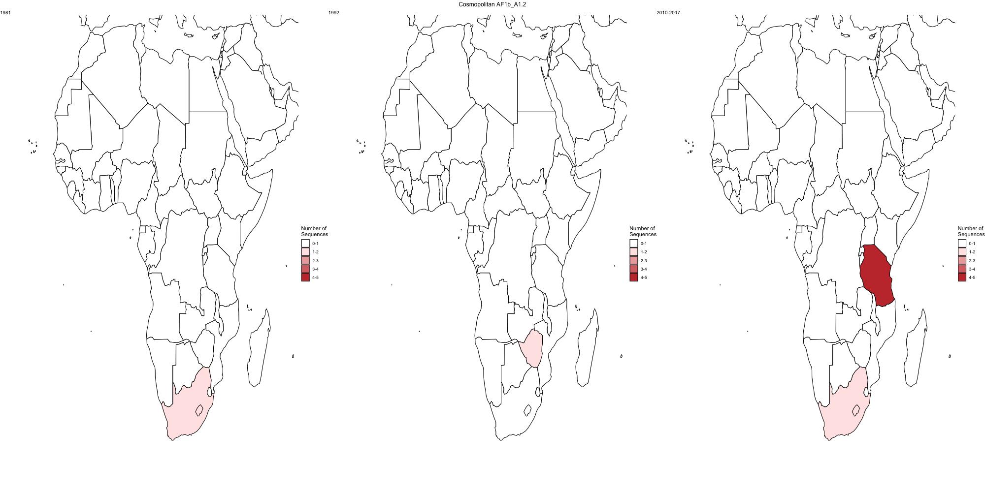
1981
1992
2010 - 2017
Fig7: Global distribution of whole genome designated lineage AF1b_A1.2 over time (n=7).

Slide 8
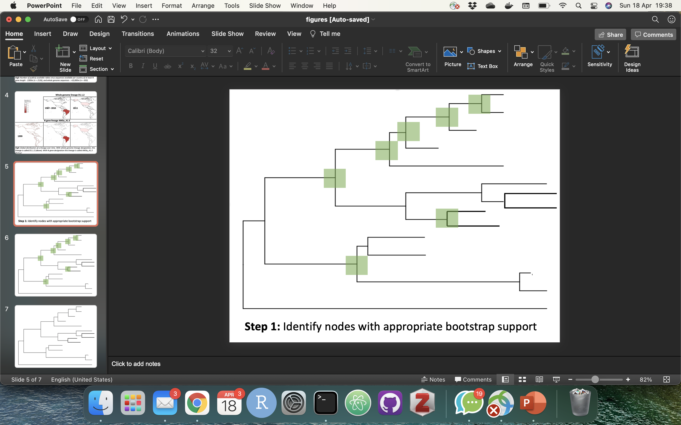
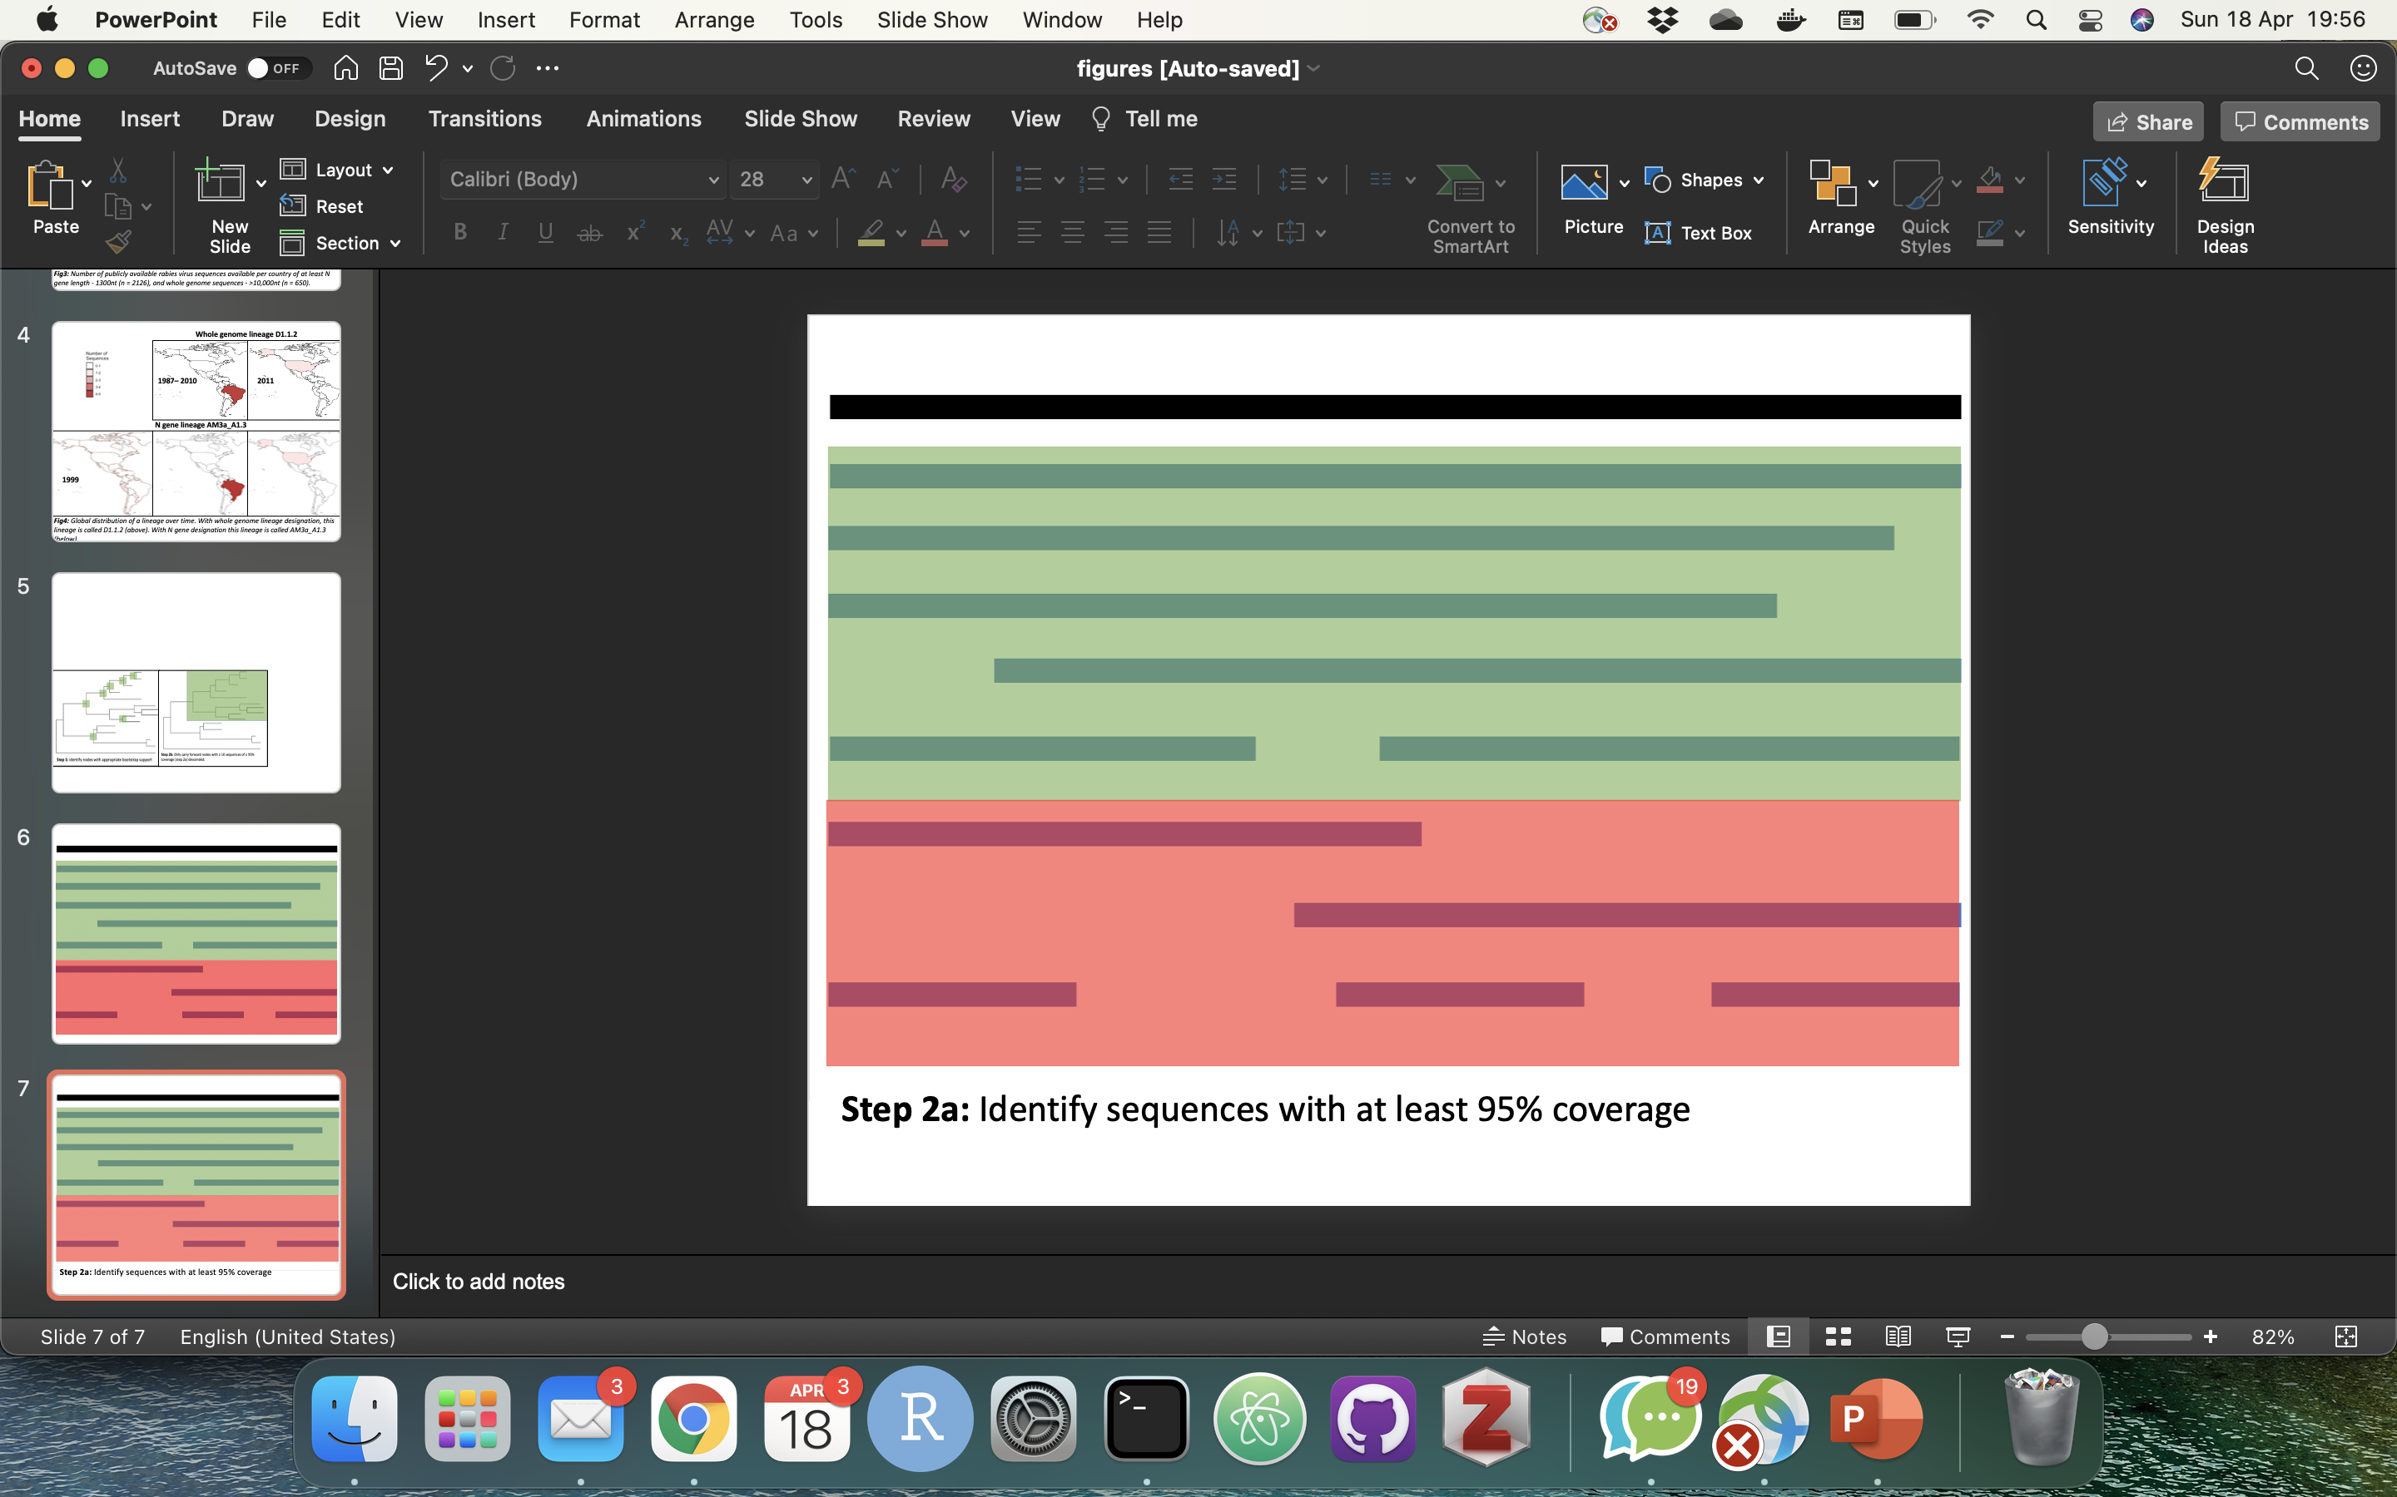
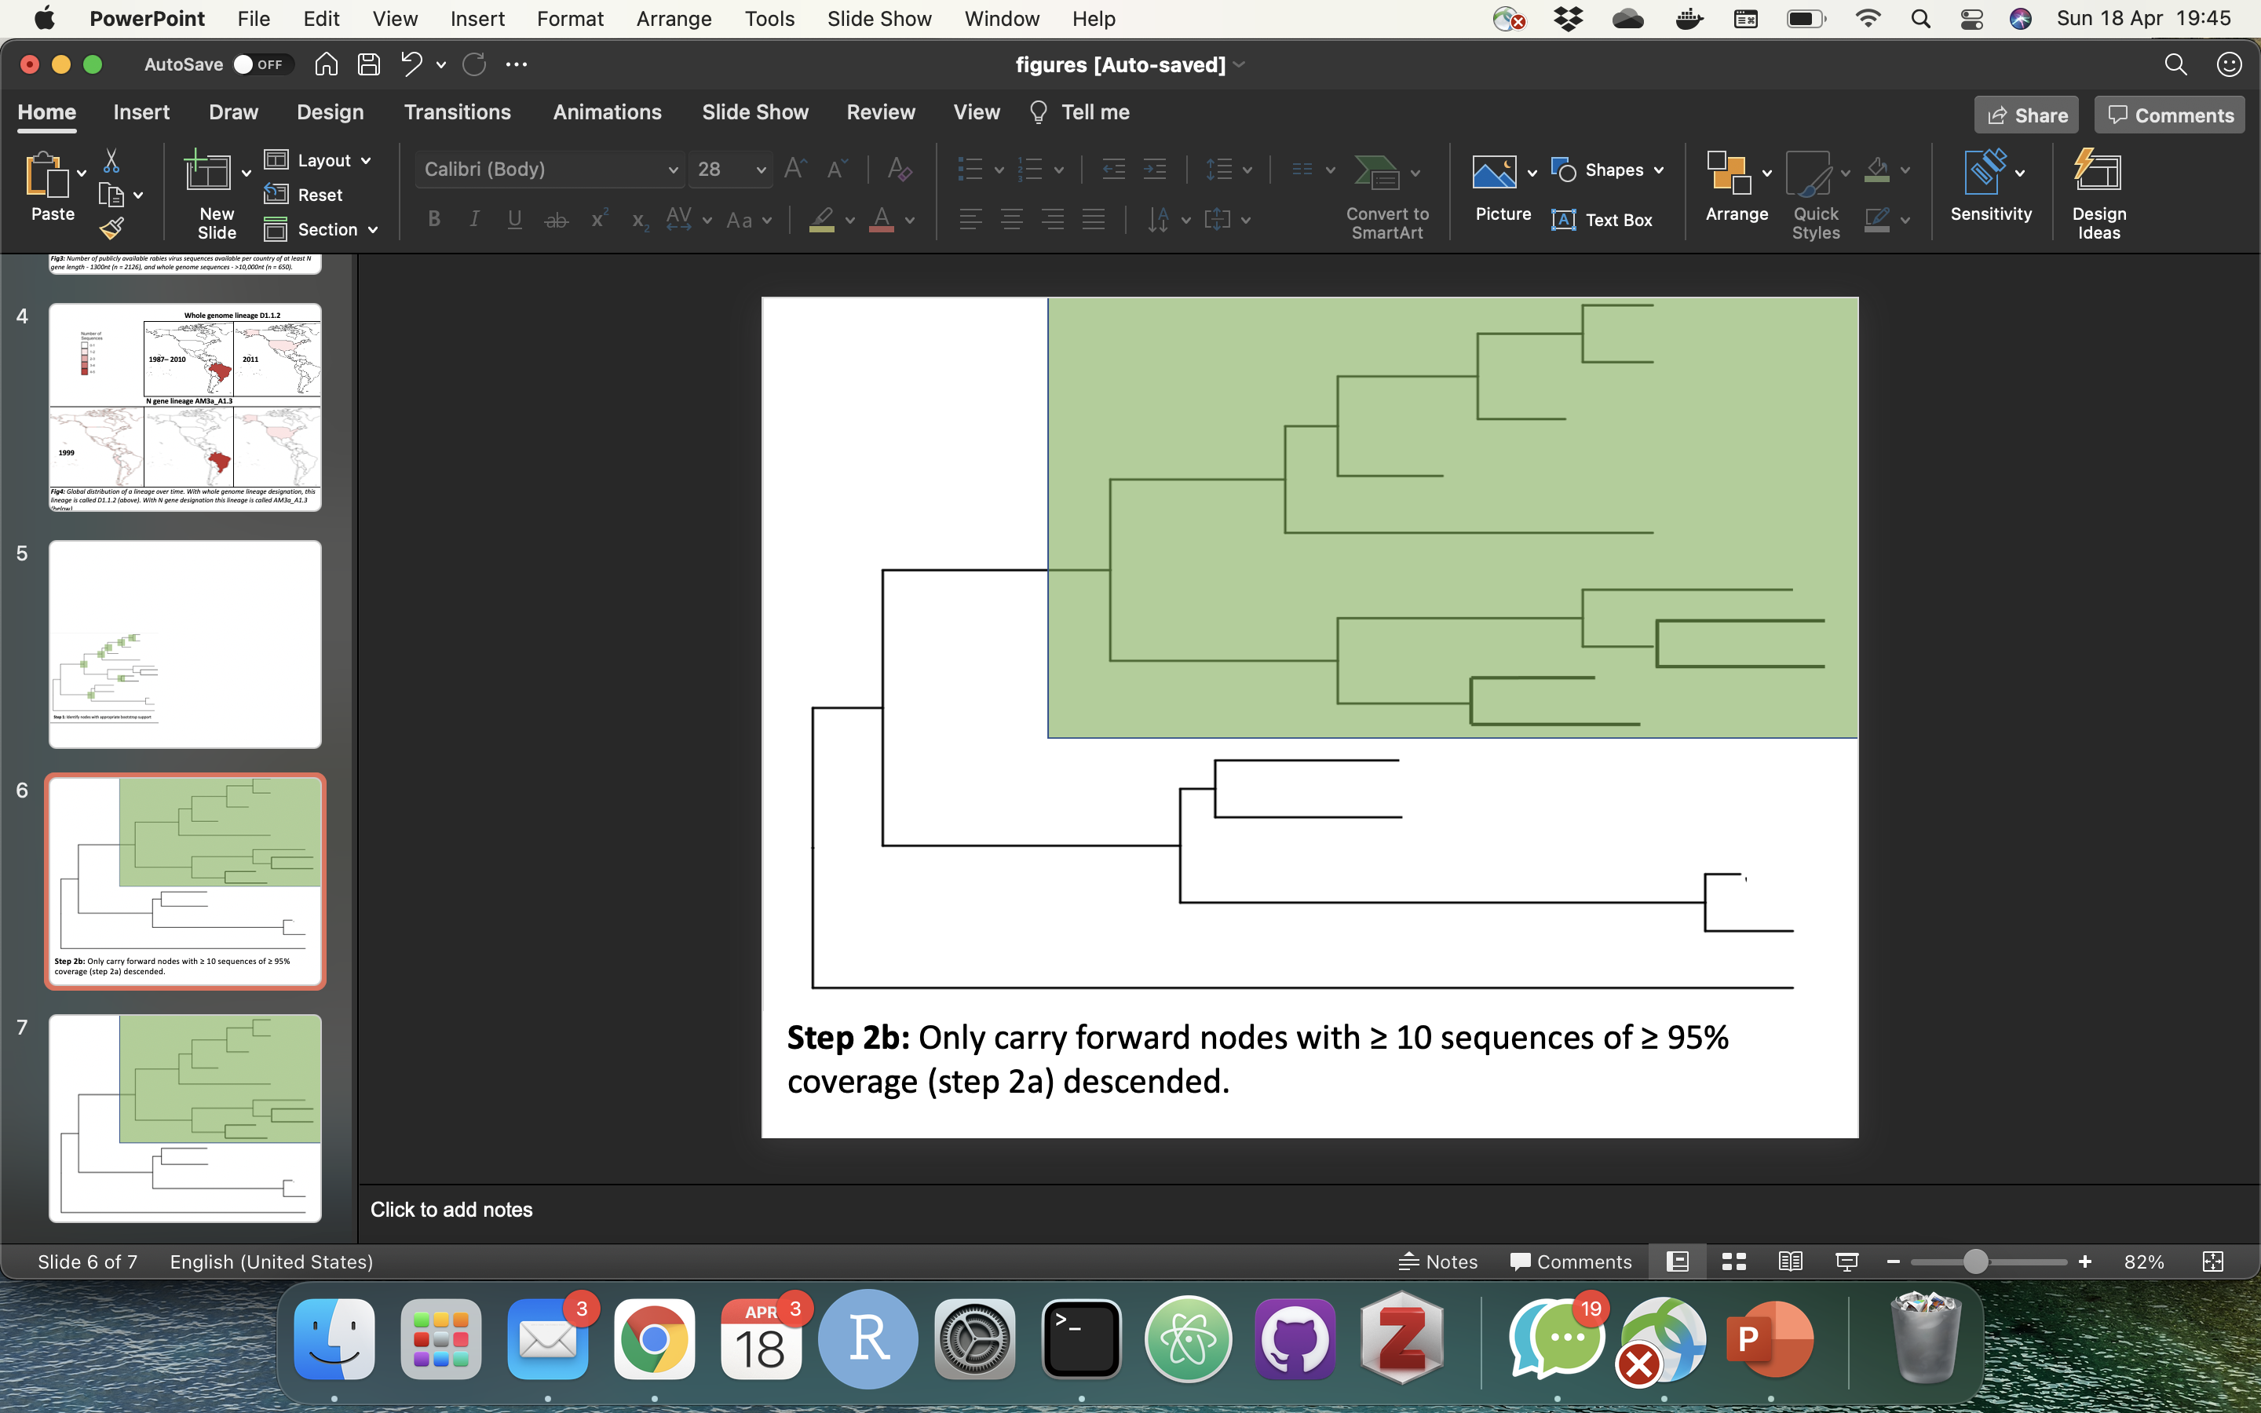
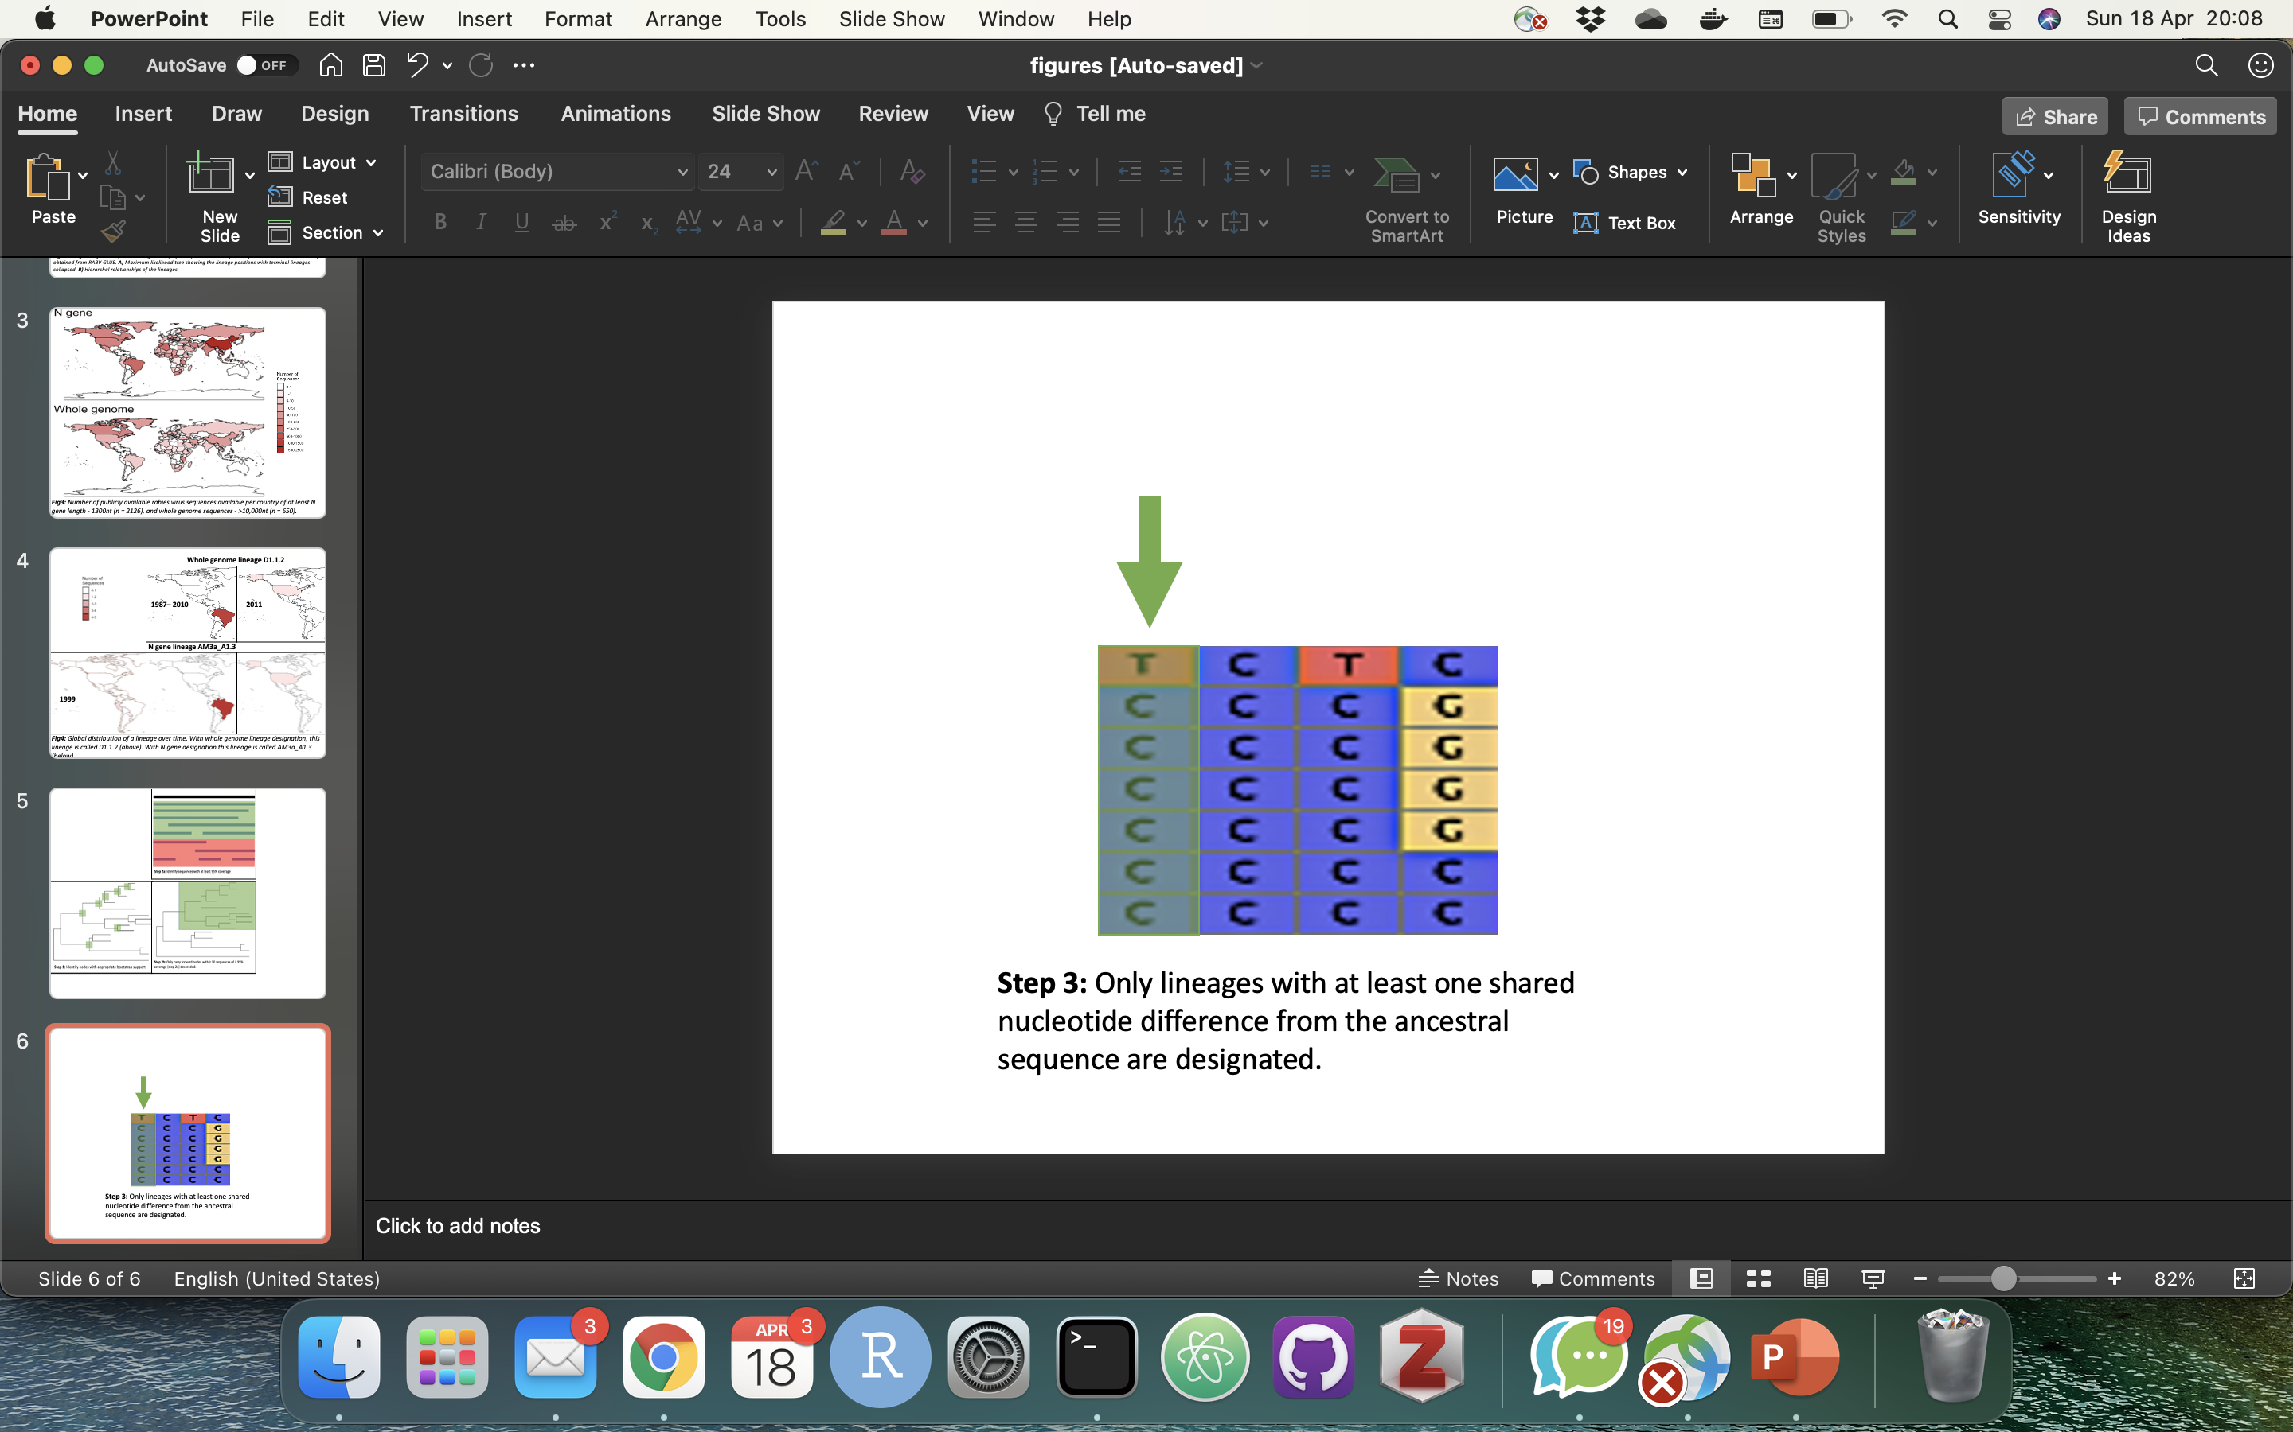
Step 4: Only lineages with at least one shared nucleotide difference from the ancestral sequence are designated
Step 1: Identify nodes with appropriate bootstrap support
Step 2: Identify sequences with at least 95% coverage
Step 3: Only carry forward nodes with ≥ 10 sequences of ≥ 95% coverage descended
Fig8: Summary of lineage designation steps

Slide 9
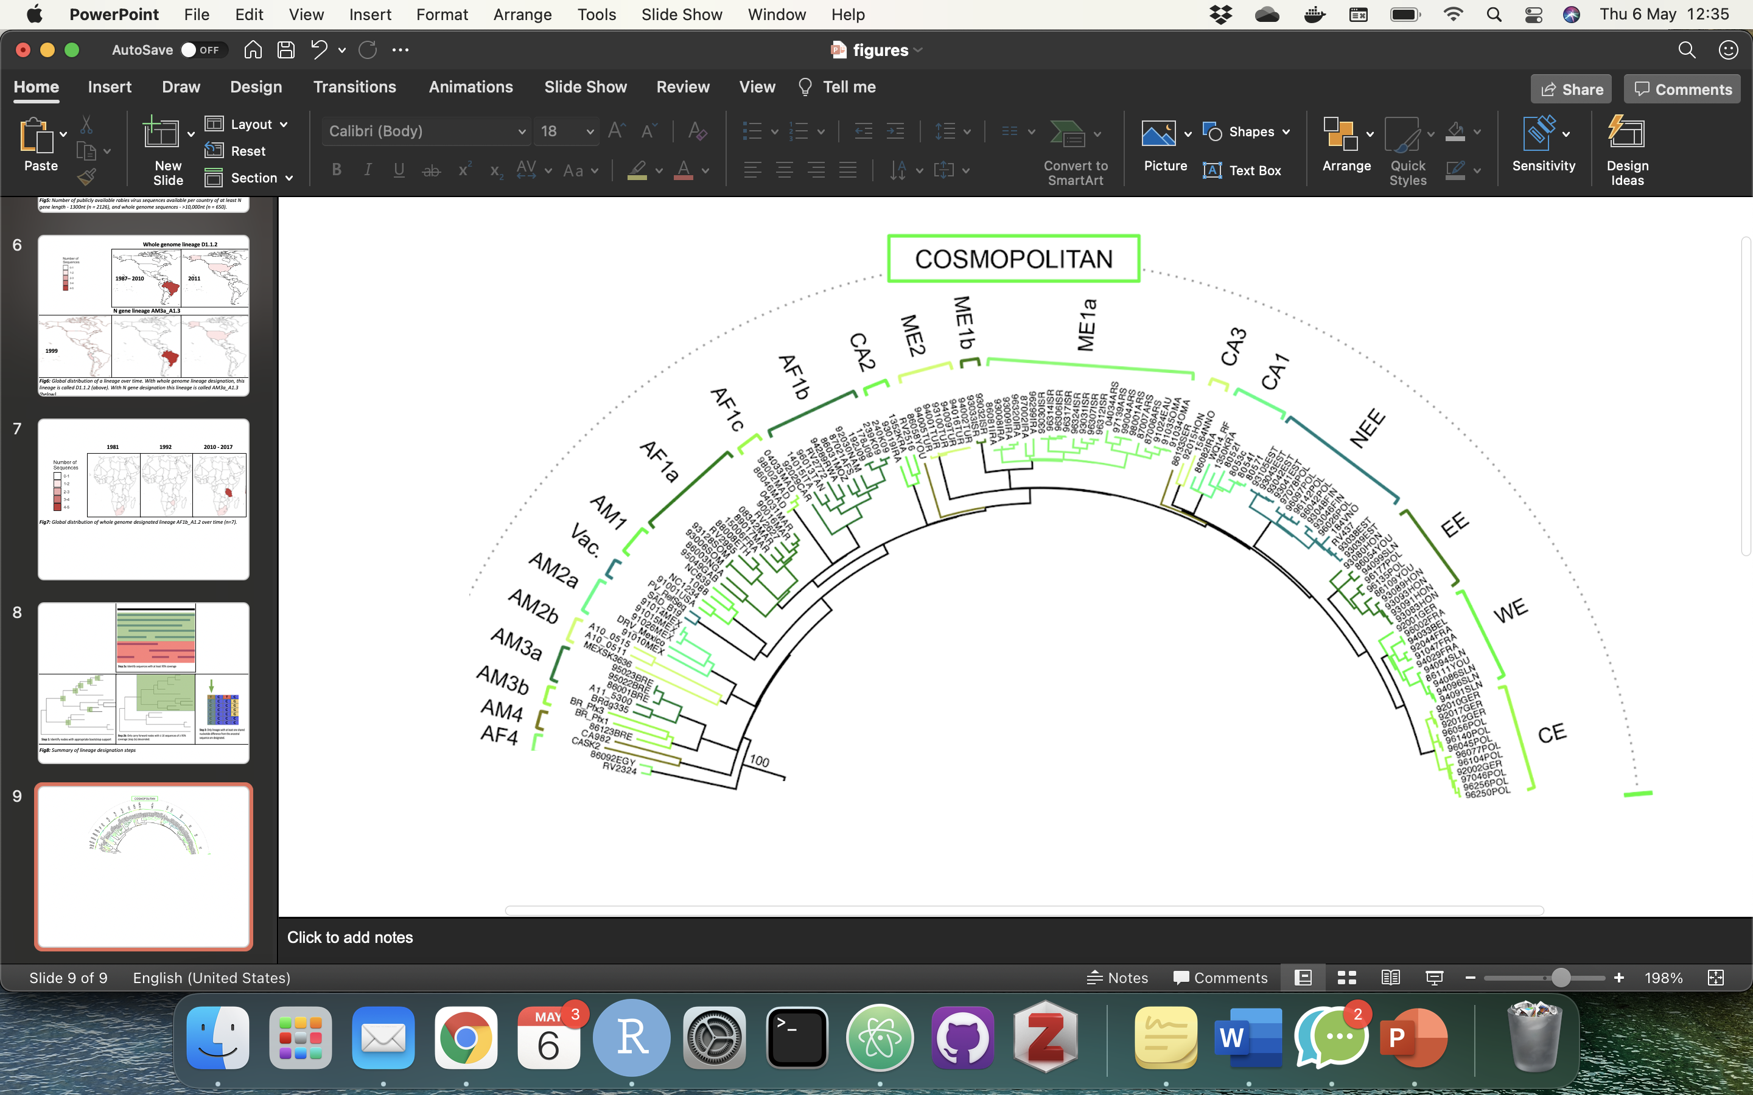
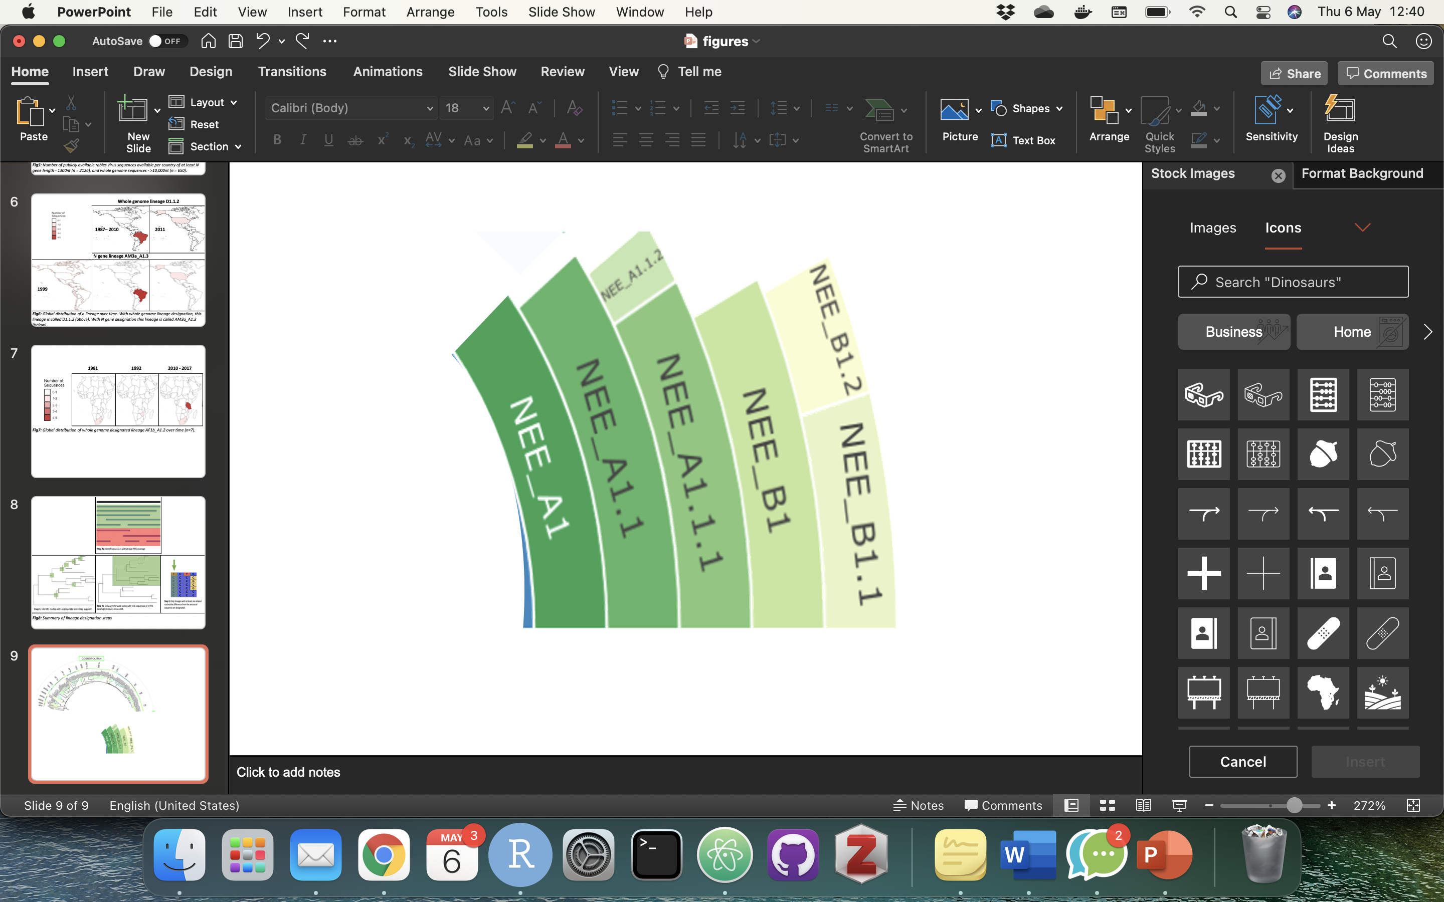
Clade
Subclade
Minor lineage
Major lineage

Slide 10
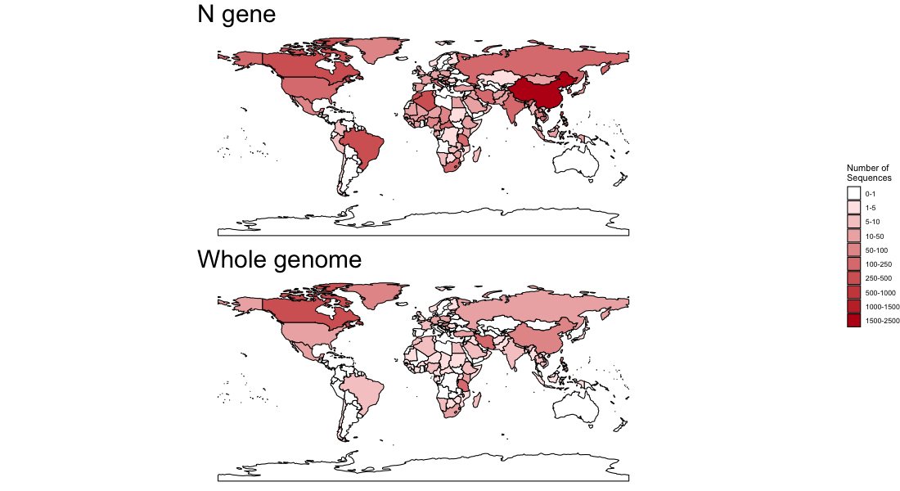
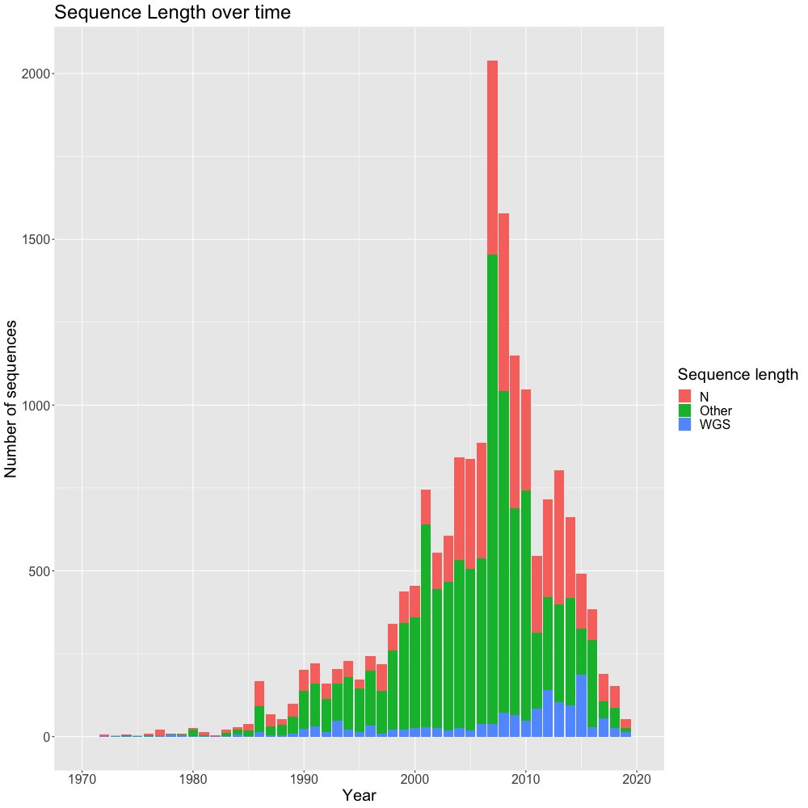

Slide 11
Sequences from GenBank
Reference alignments, trees and sequences
Curation
Web interface to database
User input sequences
Input sequences compared to references
Options to filter
Downloadable sequences, metadata and alignments
Genome visualization and comparison to reference
Clade assignment
Placement in phylogenetic tree

